Slide 1
Habit Tracker
Unique Digital experience

Slide 2
What problem does the “Habit Tracker” solve?
Habit tracker
Our team members are:
Amira
David
Ivan
Jessica
Jonathan
Sometimes daily and weekly tasks can be difficult to manage and could be overwhelming, especially for people juggling multiple responsibilities. Many people rely on paper planners or basic phone reminders. These tools usually lack flexibility. So we thought user needs a simple and digital way to keep them consistent

Slide 3
Who is the client or the end-users?
Habit tracker
Our users or clients are:
1-Busy professionals: It could help them track weekly plans,and projects. It also can organize their weekly schedules and track ongoing projects.
2-Educators: It helps them track and monitor lesson progress, grade completion and It provides a clear way to stay consistent and organized.
3- Families: It can assign and track house chores,routines or family activities Parents and children can visually see what activities been assigned and done.
4-Students: It Can log and monitor academic and personal habits, such as homework, study time, workouts.

Slide 4
The goal of the App:
Habit tracker
Ultimately,Our App goal is to make habit and activity tracking easy, flexible, and accessible, allowing users to focus on completing their goals without the complexity of traditional planning tools.

Slide 5
2-The system design

Slide 6
System Design & Technology
A] We developed our project using Ruby on Rails as the main framework
B]We used cucumber for behavior driven testing
Features and technology used:
Frontend | HTML, CSS,JavaScript
Backend | Ruby on Rails
Database | Sqlite(testing)/Postgresql(producton)
Design tools | Figma for UI mockups
Deployment and collaboration | Heroku

Slide 7
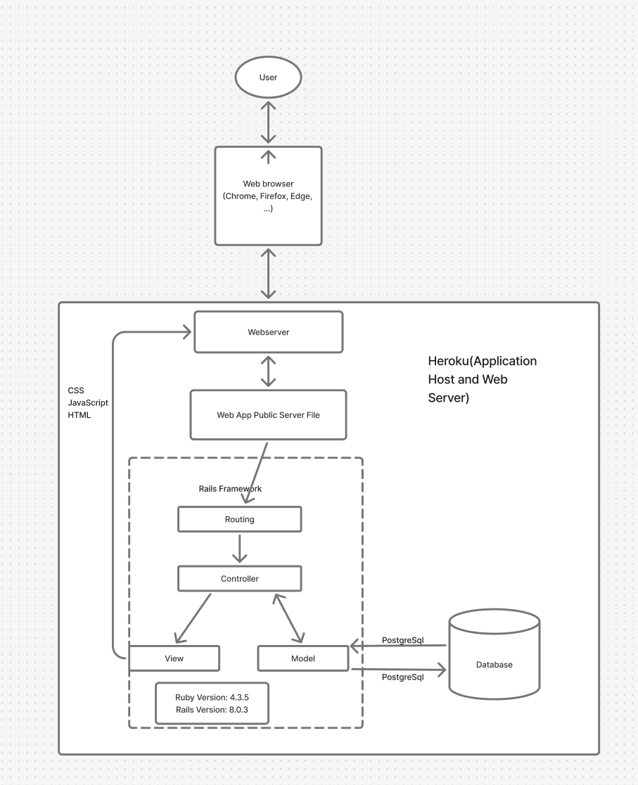
Frameworks

Slide 8
Database
ActivityEvent
Id
userId
activityId
Duration (start-end)
Repeat
User
Name
Email
Password
ActivityCategories
Holiday
Exercise
Studying
Chores

Slide 9
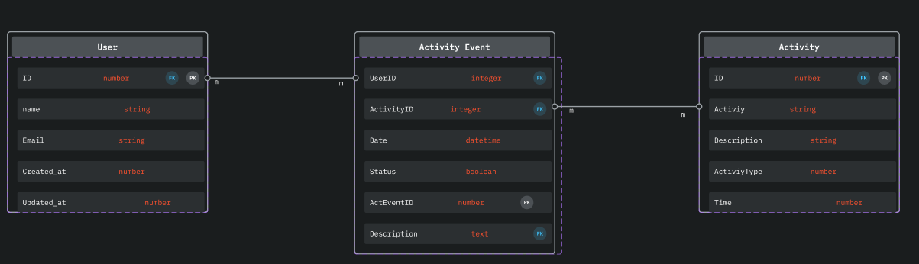
Diagrams

Slide 10
Design Pattern : Model-View-Controller

Slide 11
UI design
A-Lo-fi UI mockups and storyboards.
B-Frameworks and tools used
Design principles applied.
C-Identify and justify major UI design choices.
Notes:
Describe use of AI tools
Which tools were used and what were they used to do?
Present challenges encountered and lessons learned
How will these lessons be applied to future projects?
Present future plans/opportunities
What are the next steps for the project?

Slide 12
Behaviour Driven Design
Using Cucumber we created a collection of different user stories that we used to dictate our design. Following the format of: As a User, I want to ___ so that I can ___.
As a User, I want to manage weekly tasks so that I can better manage my time.

Slide 13

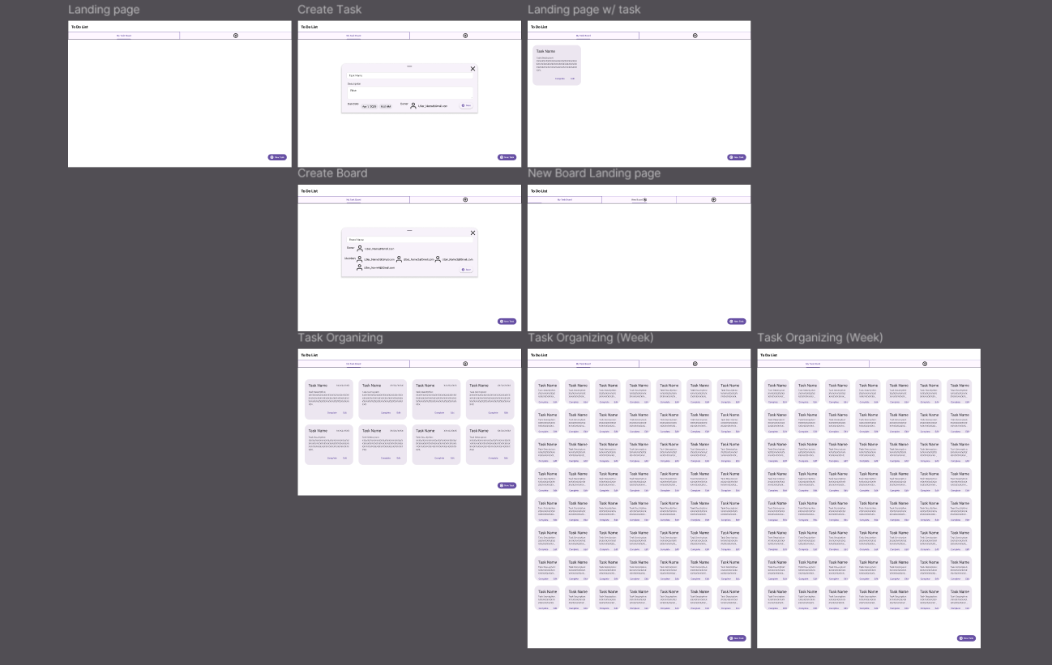
Figma
We used Figma for our initial design and prototype.

Slide 14
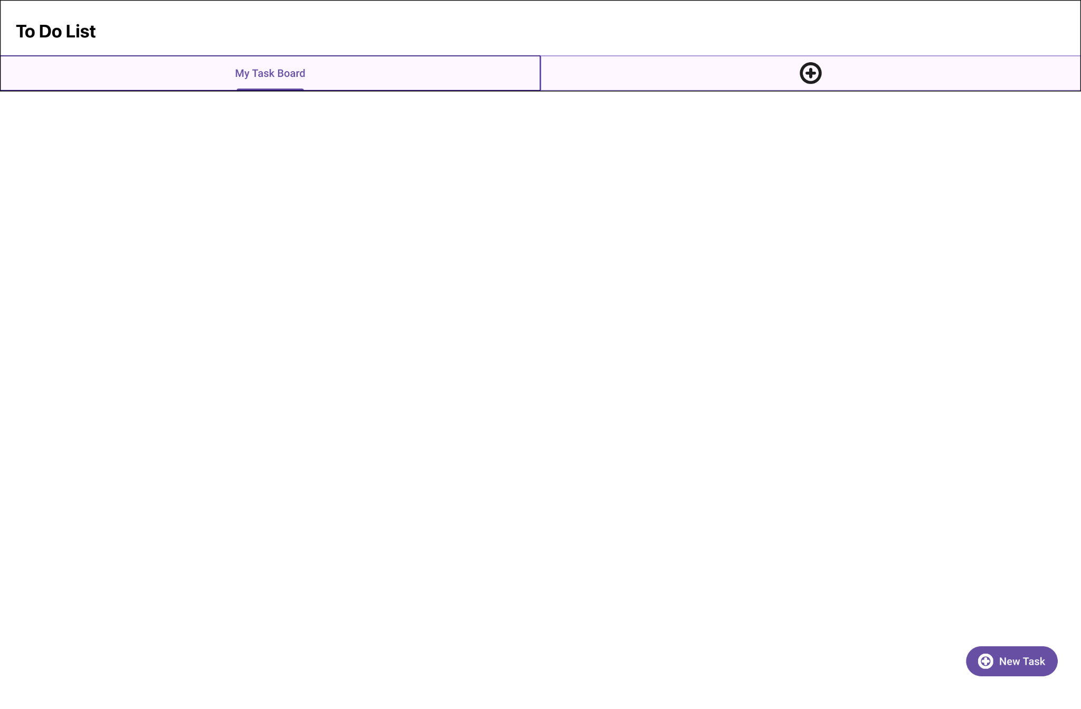

Slide 15
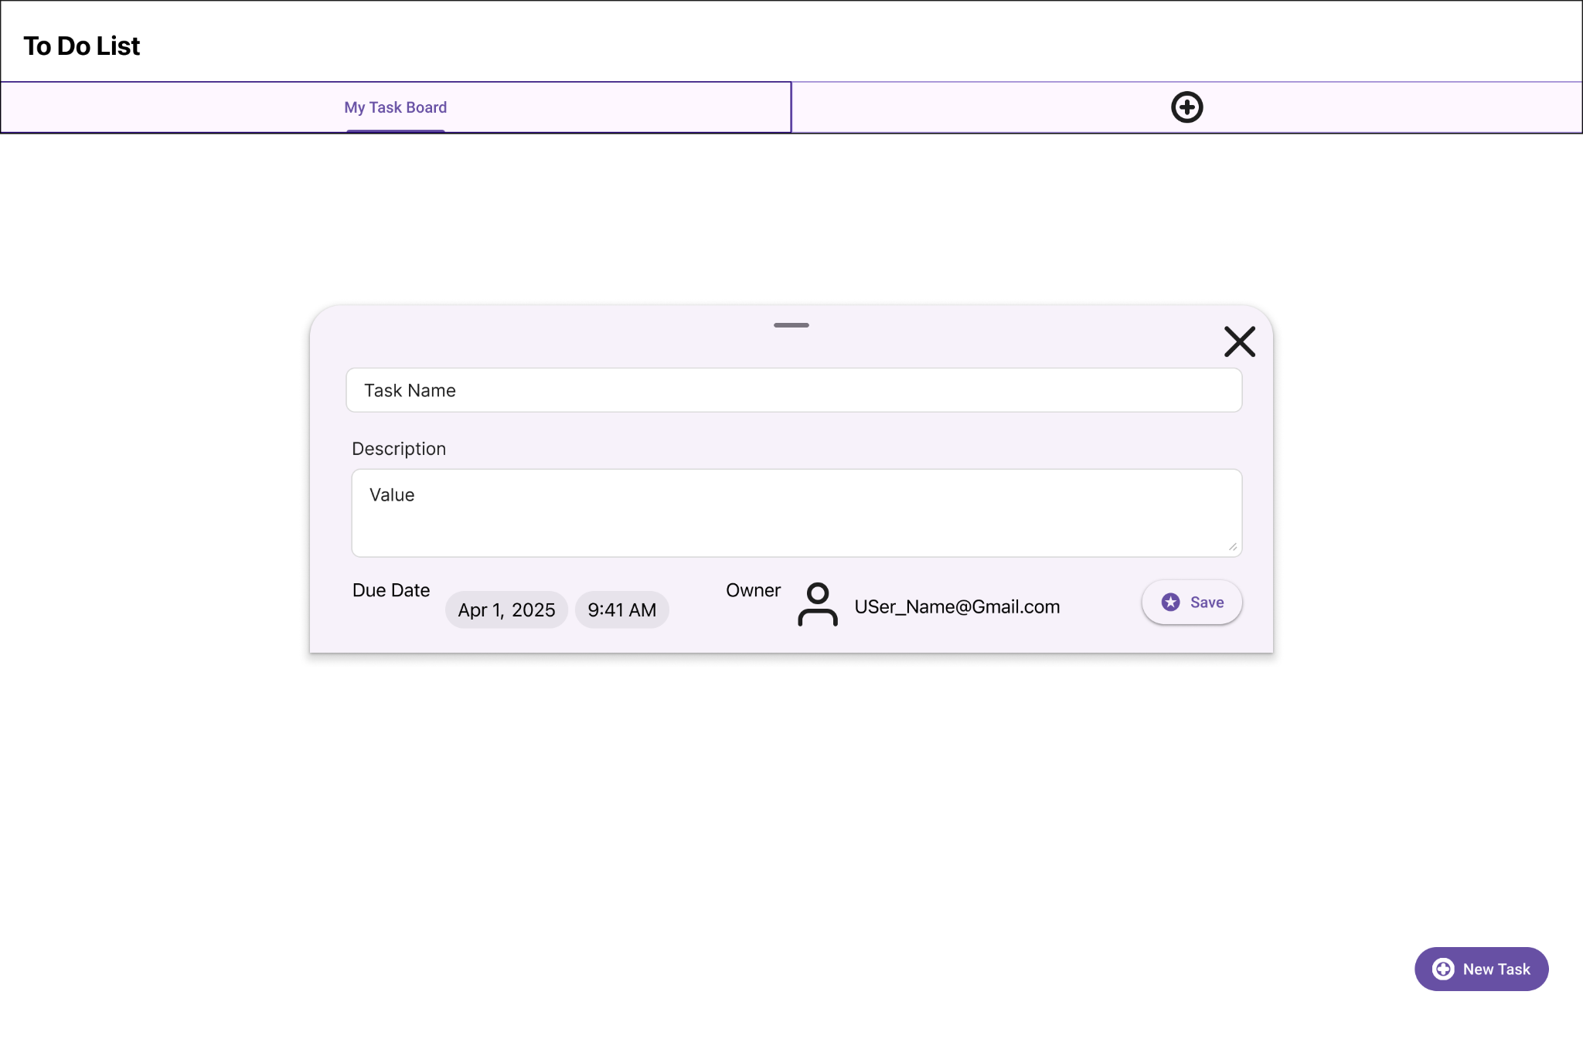

Slide 16
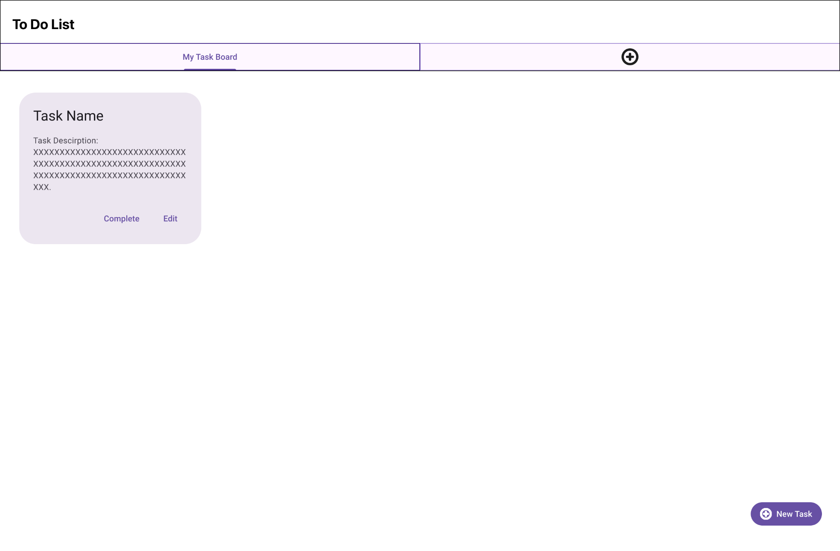

Slide 17
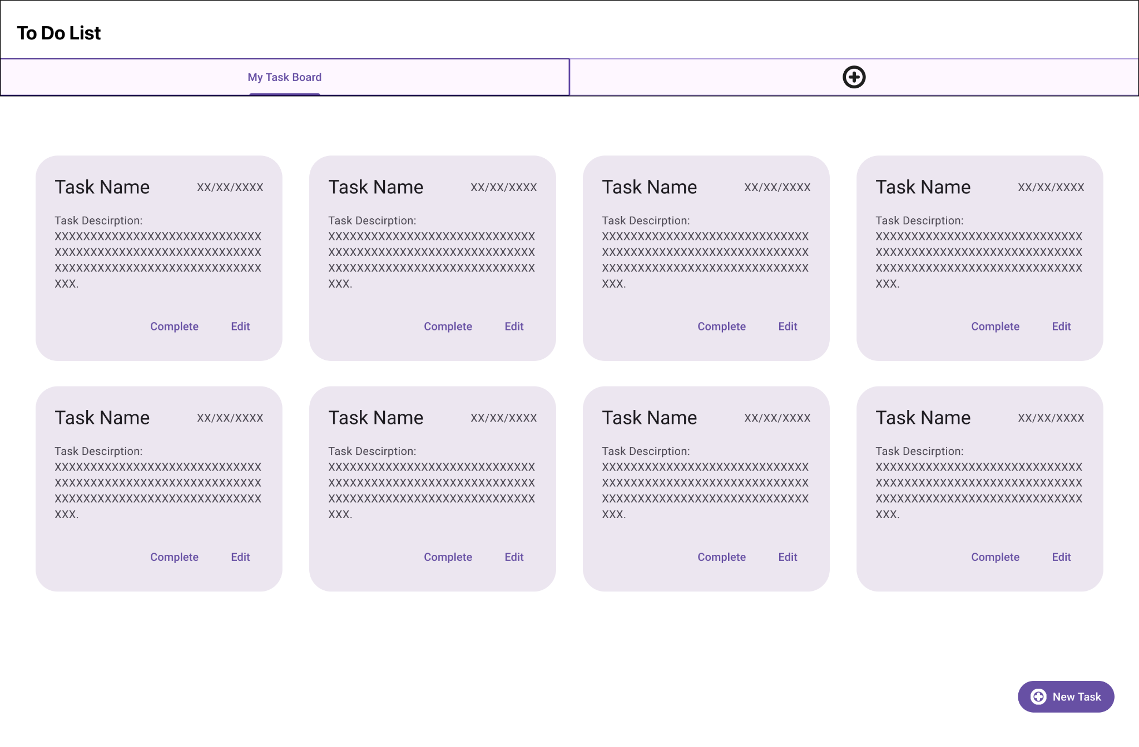

Slide 19
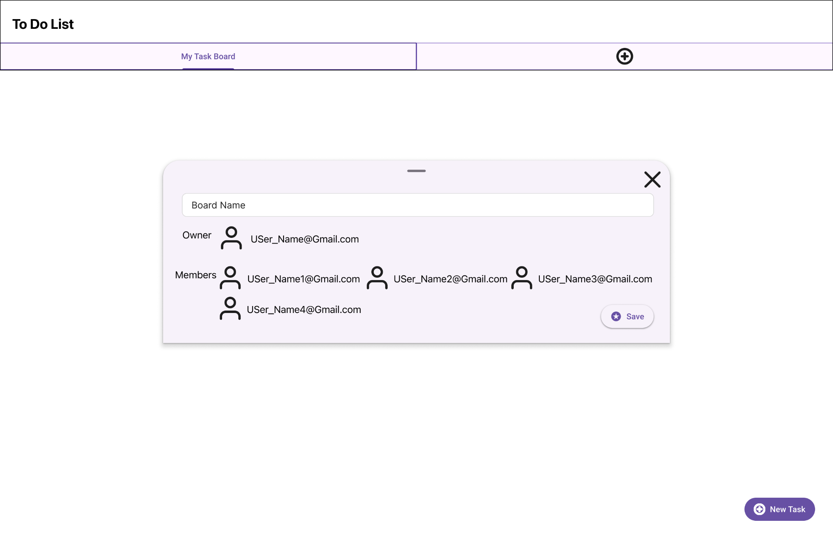

Slide 20
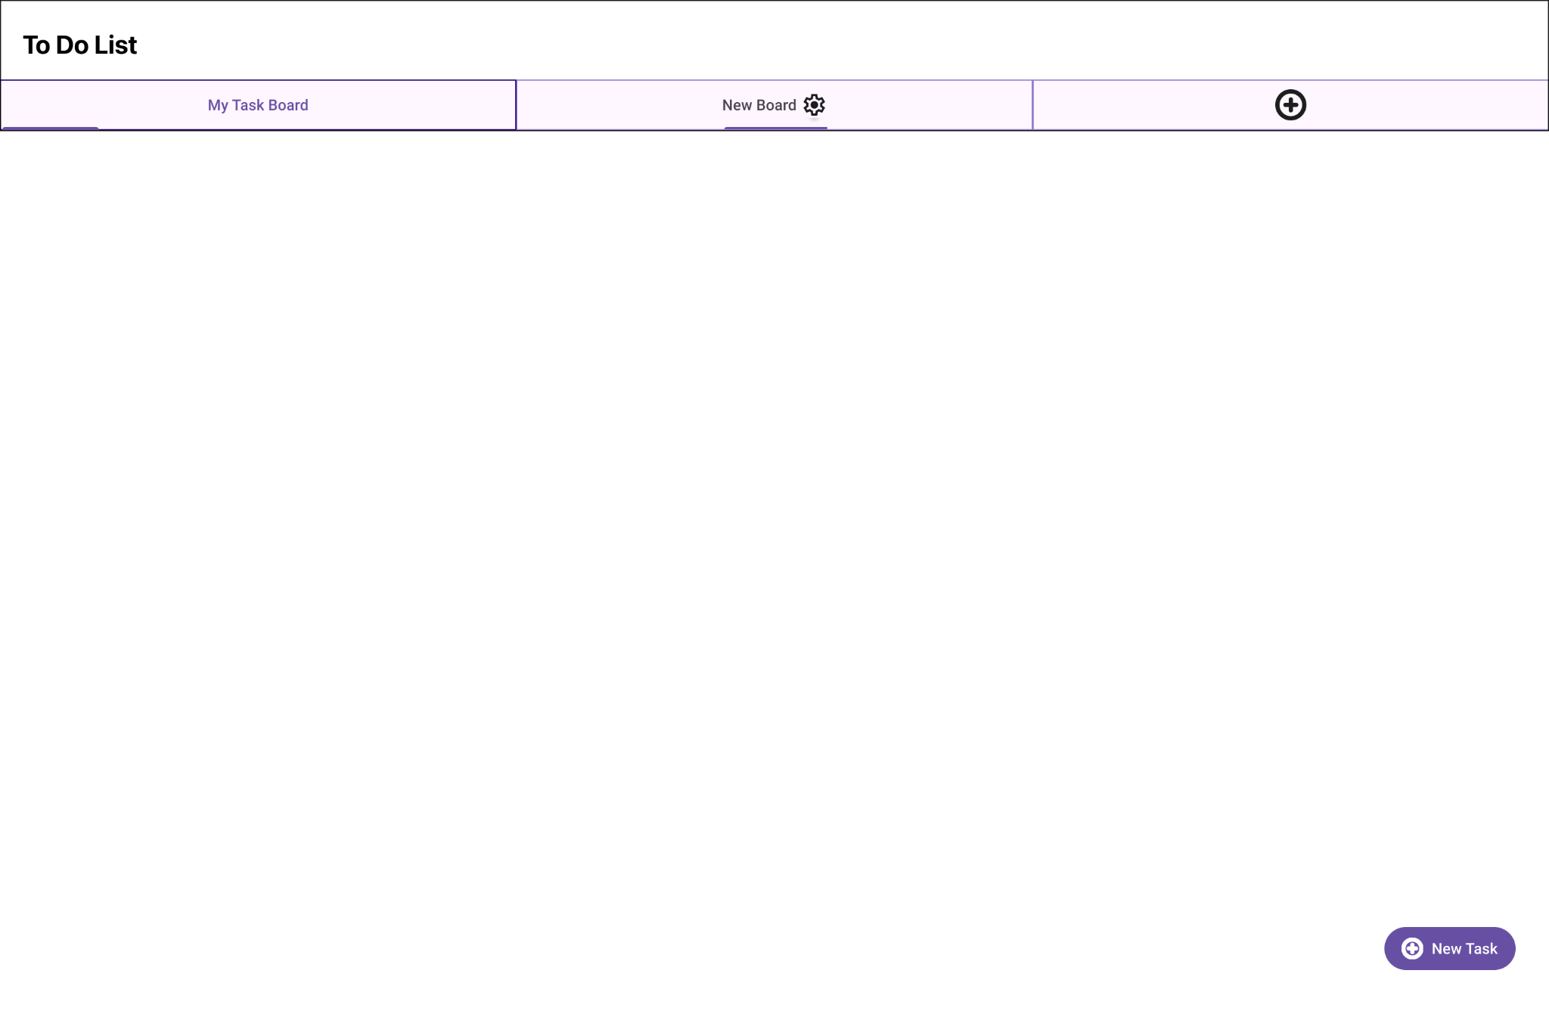

Slide 21
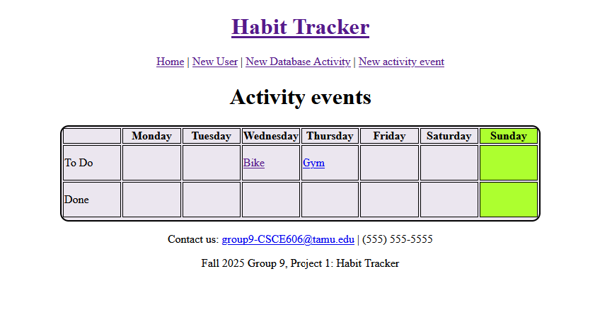
Design Principles
Alignment
Hierarchy
Color
Lines

Slide 22
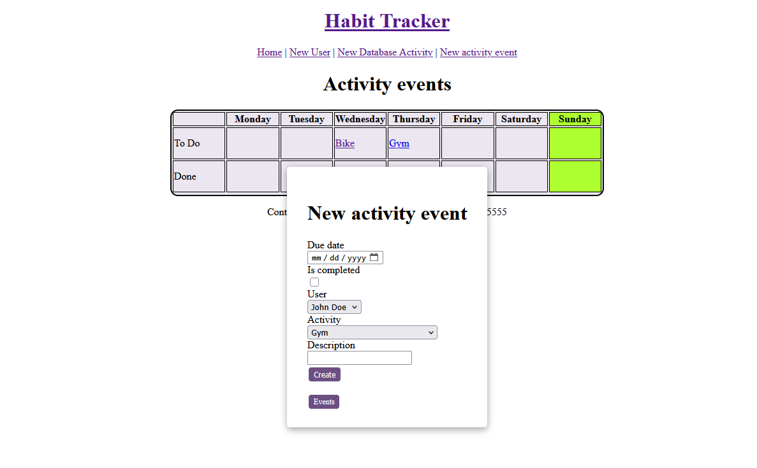
Major Choices - Modals
Modals for data Model creation, viewing and editing.
A modal provides dominance and proportion
Allowing them to see what activities currently exist.

Slide 23
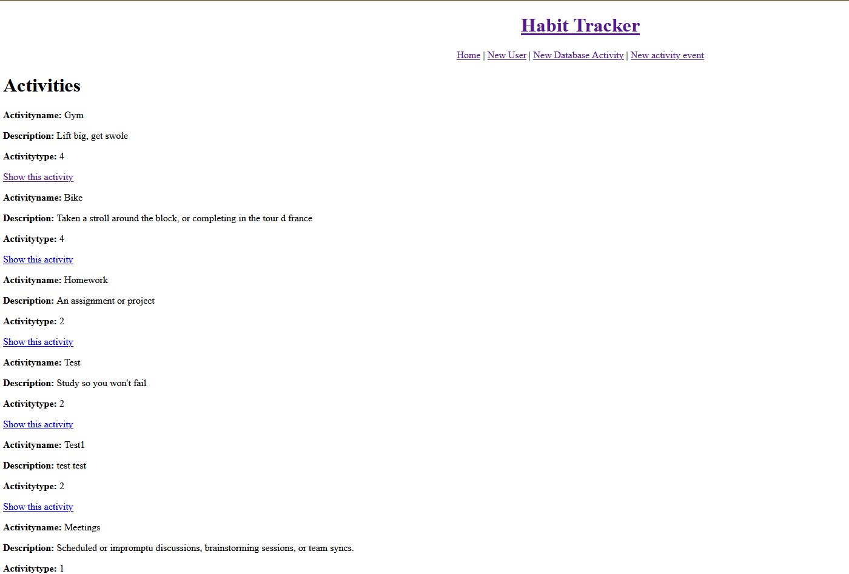
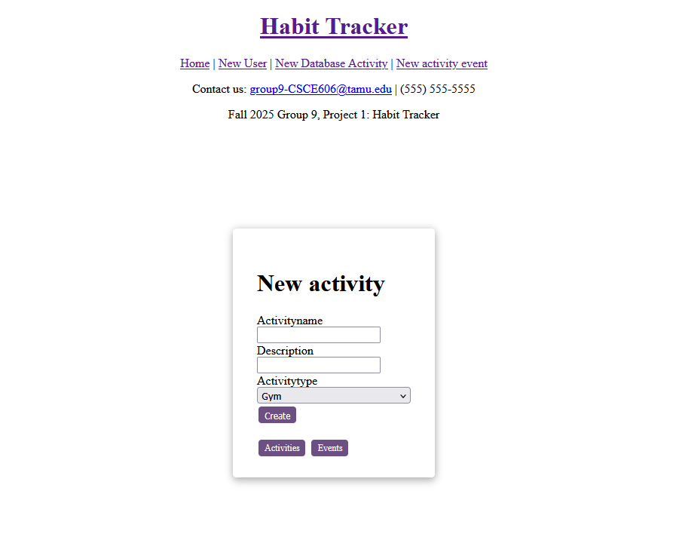
Major Choices - Users and Activities
Users and activities are obfuscated from the user by a large interaction cost.
We want to encourage a design where users reuse activities and users for their weekly events.

Slide 24
Future Plans and Opportunities
Improve security!
AI integration
overdue task alerts
Completed task garbage collection
Add task priorities (order of urgency)
Filter tasks by due-date, user, etc.
Repeating activities (multiple times per week, same day multiple over multiple weeks, etc)
Cross platform support (phones, watches, refrigerators!)
Social challenges (leaderboards with other users, completion badges)
Using additional user stories to integrate new features
Notes:
In the future we hope to be able to share this app on a larger scale. To do this, one of the first and most important updates we want to implement is improving data security. Enforcing strict content-safety-policies, and introducing user accounts that integrate security measures such as two-factor authorization are especially important if we want to be able to have users interact socially in a shared environment.
Additionally, we would want to be able to integrate AI models, such as natural-language models to assist in quicker task creation and offering due-date suggestions.
To maintain organization within the weekly calendar grid, we have a few feature upgrades. This includes an alert or easy-to-see indicator when a task is overdue, a button to quickly delete all of the completed items from the grid, the ability to rank tasks based on importance, or filter tasks by due-date or users, and the ability to make activities repeatable, since people often to the gym multiple times per week or having a recurring meeting on the same day every week.
Lastly, after improved security is in place, we can then focus on making our app more accessible to larger audiences. This could include adding new compatibility with other platforms such as phones, smart watches, etc. And we we want be able to integrate community features within the app. This could include social challenges where you could have a leaderboard and completion badges among members in a shared environment.
There’s always room for improvement, so we want to continue using new user stories to integrate useful features people will want to use.

Slide 25
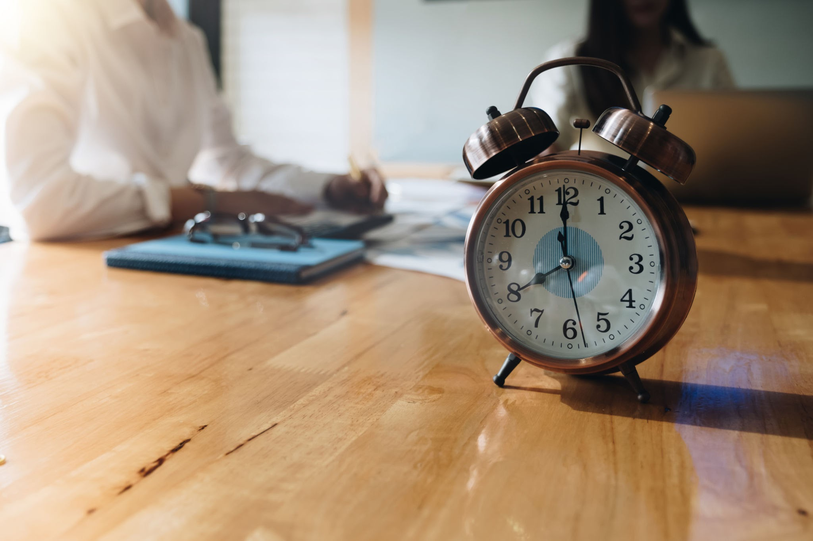
Challenges
1-Time management
2-Environment management (Mac, Windows, Linux, packages, Github)
3-Data Model changes

Slide 26
Lessons Learned
Best team practices
Project planning
Pair programming
Communication
Environment management
Version control
PRs
Documentation
Lots of Ruby!
JavaScript in Rails
Agile Programming

Slide 27
Contact
Group 9

